Slide 2
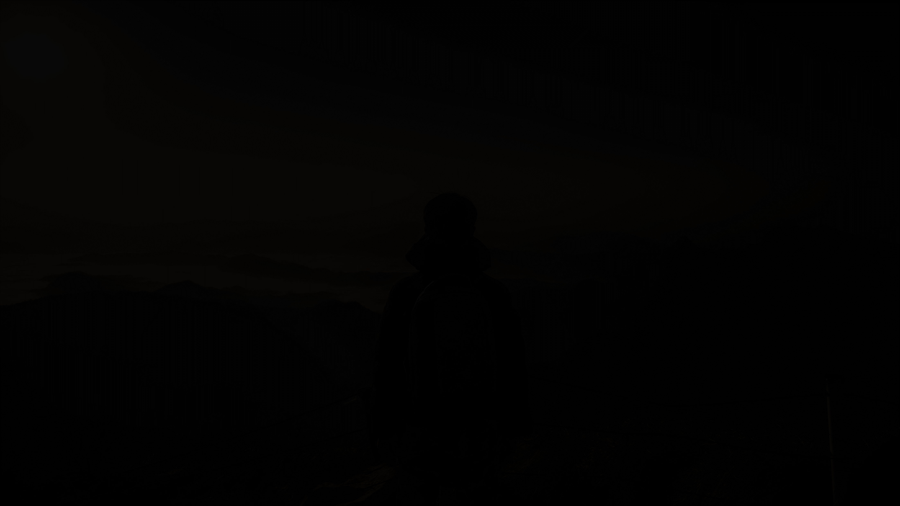
SAINTS
and
SINNERS

Slide 3
What Is A Saint?
Someone who has been dead long enough for everyone to forget about the bad things they have done
“A saint is a holy person who is known for his or her “heroic sanctity” and who is thought to be in heaven.”
Romans 1:6,7 “called of Jesus Christ” “called {to be} saints."
1 Corinthians 1:2 “church of God which is at Corinth, to those who are sanctified in Christ Jesus, called {to be} saints”
Sanctified –hagiazo “ to make holy, i.e. (ceremonially) purify or consecrate."
Saints – hagios “, sacred (physically, pure, morally blameless or religious, ceremonially, consecrated)."
To be SANCTIFIED is to be called a SAINT!

Slide 4
Saints Are Those Who:
Know The Truth – John 8:32 NKJV 32 "And you shall know the truth, and the truth shall make you free."
Have taken the REST offered by Christ – Matthew 11:28-30
Have Life through Christ – John 10:10 NKJV 10 "The thief does not come except to steal, and to kill, and to destroy. I have come that they may have life, and that they may have it more abundantly.”
Have Peace In Christ – John 14:27 NKJV 27 "Peace I leave with you, My peace I give to you; not as the world gives do I give to you. Let not your heart be troubled, neither let it be afraid.”
Have an Incorruptible Inheritance – 1 Peter 1:3-5

Slide 5
How Does One Become A Sinner?
Matthew 7:13,14 “narrow {is} the gate and difficult {is} the way which leads to life, and there are few who find it."
Jesus says the Majority Will Not Make It To Heaven!
2 Peter 1:5-7 “giving all diligence, add to your faith virtue, to virtue knowledge, (6) to knowledge self control, to self control perseverance, to perseverance godliness, (7) to godliness brotherly kindness, and to brotherly kindness love."
2 Peter 1:10,11 “Therefore, brethren, be even more diligent to make your calling and election sure, for if you do these things you will never stumble; (11) for so an entrance will be supplied to you abundantly into the everlasting kingdom of our Lord and Savior Jesus Christ."
OTHER saints will become SINNERS – NOT FAITHFUL Revelation 2:10

Slide 6
What Causes A Saint To Become A Sinner?
APATHY – “lack of interest, listless conditions, indifference.” (Web.)
Matthew 24:11-13 “the love of many will grow cold.”
Apathy will be the reason who MANY SAINTS lose their eternal souls!
WORLDLINESS – 2 Timothy 4:10 “having loved this present world”
Galatians 5:19-24 “works of the FLESH are evident….”
REVELRIES - "feasts and drinking parties that are protracted till late at night and indulge in revelry."
Does NOT necessarily describe drunkenness - "sipping of intoxicating beverages."

Slide 7
What Causes A Saint To Become A Sinner?
DISOBEDIENCE – Hebrews 10:25 – Failing to attend assemblies
1 Corinthians 16:1,2 – Failing to give in proportion to prosperity
Hebrews 3:12-15 “hardened through the deceitfulness of sin.”
FALSE DOCTRINES – 1 John 4:1 “Beloved, do not believe every spirit, but test the spirits, whether they are of God; because many false prophets have gone out into the world."
2 John 9-11 “Whoever transgresses and does not abide in the doctrine of Christ does not have God. He who abides in the doctrine of Christ has both the Father and the Son. If anyone comes to you and does not bring this doctrine, do not receive him into your house nor greet him; for he who greets him shares in his evil deeds.”

Slide 8
HEAVEN IS THE GOAL FOR SAINTS
John 14:2-3 NKJV 2 "In My Father's house are many mansions; if it were not so, I would have told you. I go to prepare a place for you. 3 "And if I go and prepare a place for you, I will come again and receive you to Myself; that where I am, there you may be also.”
Where is this place?
Colossians 3:1 “If then you were raised with Christ, seek those things which are above, where Christ is, sitting at the right hand of God.”
Luke 10:20 "...rejoice because your names are written in heaven."
HEAVEN is where SAINTS ARE HEADED!

Slide 9
WHAT IF A SAINT TURNS INTO A SINNER?
Revelation 3:5 "He who overcomes shall be clothed in white garments, and I will not blot out his name from the Book of Life; but I will confess his name before My Father and before His angels.”
Revelation 21:27 “But there shall by no means enter it anything that defiles, or causes an abomination or a lie, but only those who are written in the Lamb's Book of Life.”
Revelation 20:15 “And anyone not found written in the Book of Life was cast into the lake of fire.”
Romans 6:16 “Do you not know that to whom you present yourselves slaves to obey, you are that one's slaves whom you obey, whether of sin leading to death, or of obedience leading to righteousness?”

Slide 10
HOW CAN A SINNER TURN BACK TO A SAINT?
James 5:19-20 “…if anyone among you wanders from the truth, and someone turns him back,…he who turns a sinner from the error of his way will save a soul from death and cover a multitude of sins.”
Acts 8:22 "Repent therefore of this your wickedness, and pray God if perhaps the thought of your heart may be forgiven you.”
1 John 1:9 “If we confess our sins, He is faithful and just to forgive us our sins and to cleanse us from all unrighteousness.”
Are YOU a “SAINT TURNED SINNER?”
Repent and COME BACK!
Never been a “SAINT?”
Why not OBEY THE GOSPEL OF CHRIST?

